Slide 1

BLOG SITE
GUIDE NAME: RIDHI SUTERI
AFFILIATION: COURSE INSTRUCTOR BATCH NUMBER – 07
PALLAPUNEEDI BHAVYA SREE - 160121771085
PASUNURI KATHYAYINI – 160121771088
DESHAMONI SREE HARSHA – 160121771100
KATARI SANJEEV VARMA - 160121771106

Slide 2

AGENDA
INTRODUCTION
SYSTEM REQUIREMENTS
METHODOLOGY
RESULTS
CONCLUSION
BIBLIOGRAPHY

Slide 3

INTRODUCTION
A Blogsite is a type of website that focuses on written content, typically in the form of blog posts or articles. Blogging has become increasingly popular in recent years as a means of sharing information, opinions, and personal experiences with a wider audience. Blog Sites can cover a wide range of topics, from personal anecdotes and lifestyle advice to news and current events, business and finance, health and wellness, travel, and much more. They offer a platform for individuals and organizations to express themselves, engage with readers, and build a community around their interests.

Slide 4




MOTIVATION
We often find individuals who struggle to freely express themselves and share their perspectives on different things they are interested on with people who are like-minded as them.
There are also people who seek motivation, knowledge and suggestions from others who are well-versed in those respective fields.
We created this blogsite to enable these both parties come together to learn and share from each other.
Storytelling is a powerful tool for building empathy, understanding and connection and we believe that our blogsite fosters this culture of open and honest communication

Slide 5
APPLICATIONS
Personal Blogging: Our blog site provides individuals with a platform to create and publish their own personal blogs, where they can express their thoughts, opinions, and experiences.
Branding and Marketing: Our blog site can be used as a tool for building personal or professional brands. Individuals and businesses can create blogs to share their expertise and establish themselves as thought leaders in their fields.
Community Building: Our blog site fosters a community of individuals who share common interests and passions. Users can engage with each other's blogs, leave comments, and connect with like-minded individuals.
Education and Learning: Our blog site can be used as a tool for education and learning. Individuals can create blogs to share their knowledge and expertise on a wide range of topics, and readers can learn from their insights and experiences.
Journalism: Our blog site can be used as a platform for citizen journalism. Individuals can create blogs to share news, opinions, and perspectives on current events, and contribute to a more diverse and democratic media landscape.
Creativity and Artistic Expression: Our blog site can be used as a platform for creative expression. Users can create blogs to share their artwork, writing, music, and other forms of creative expression with a wider audience.

Slide 6

PROBLEM STATEMENT
To create an easily accessible and user-friendly web platform where individuals can express themselves freely, share their unique perspectives through writing and help people who seek motivation and suggestions learn from each other and grow.

Slide 7
SYSTEM REQUIREMENTS
SOFTWARE REQUIREMENTS :
Operating System: Windows
Text Editor/IDE: Visual Studio Code
Programming Languages: HTML, CSS, JavaScript
Front-End Frameworks: ReactJS
Back-End Frameworks: Express.js
Java script web server: Node.js,
Application programming interface(API): Post man
Database: MongoDB
HARDWARE REQUIREMENTS:
Processor: Intel core i5
RAM: 4.0 GB
Hard Disk: Minimum 20 GB free disk space
Internet Connection: Required for accessing the website and its resources.

Slide 8
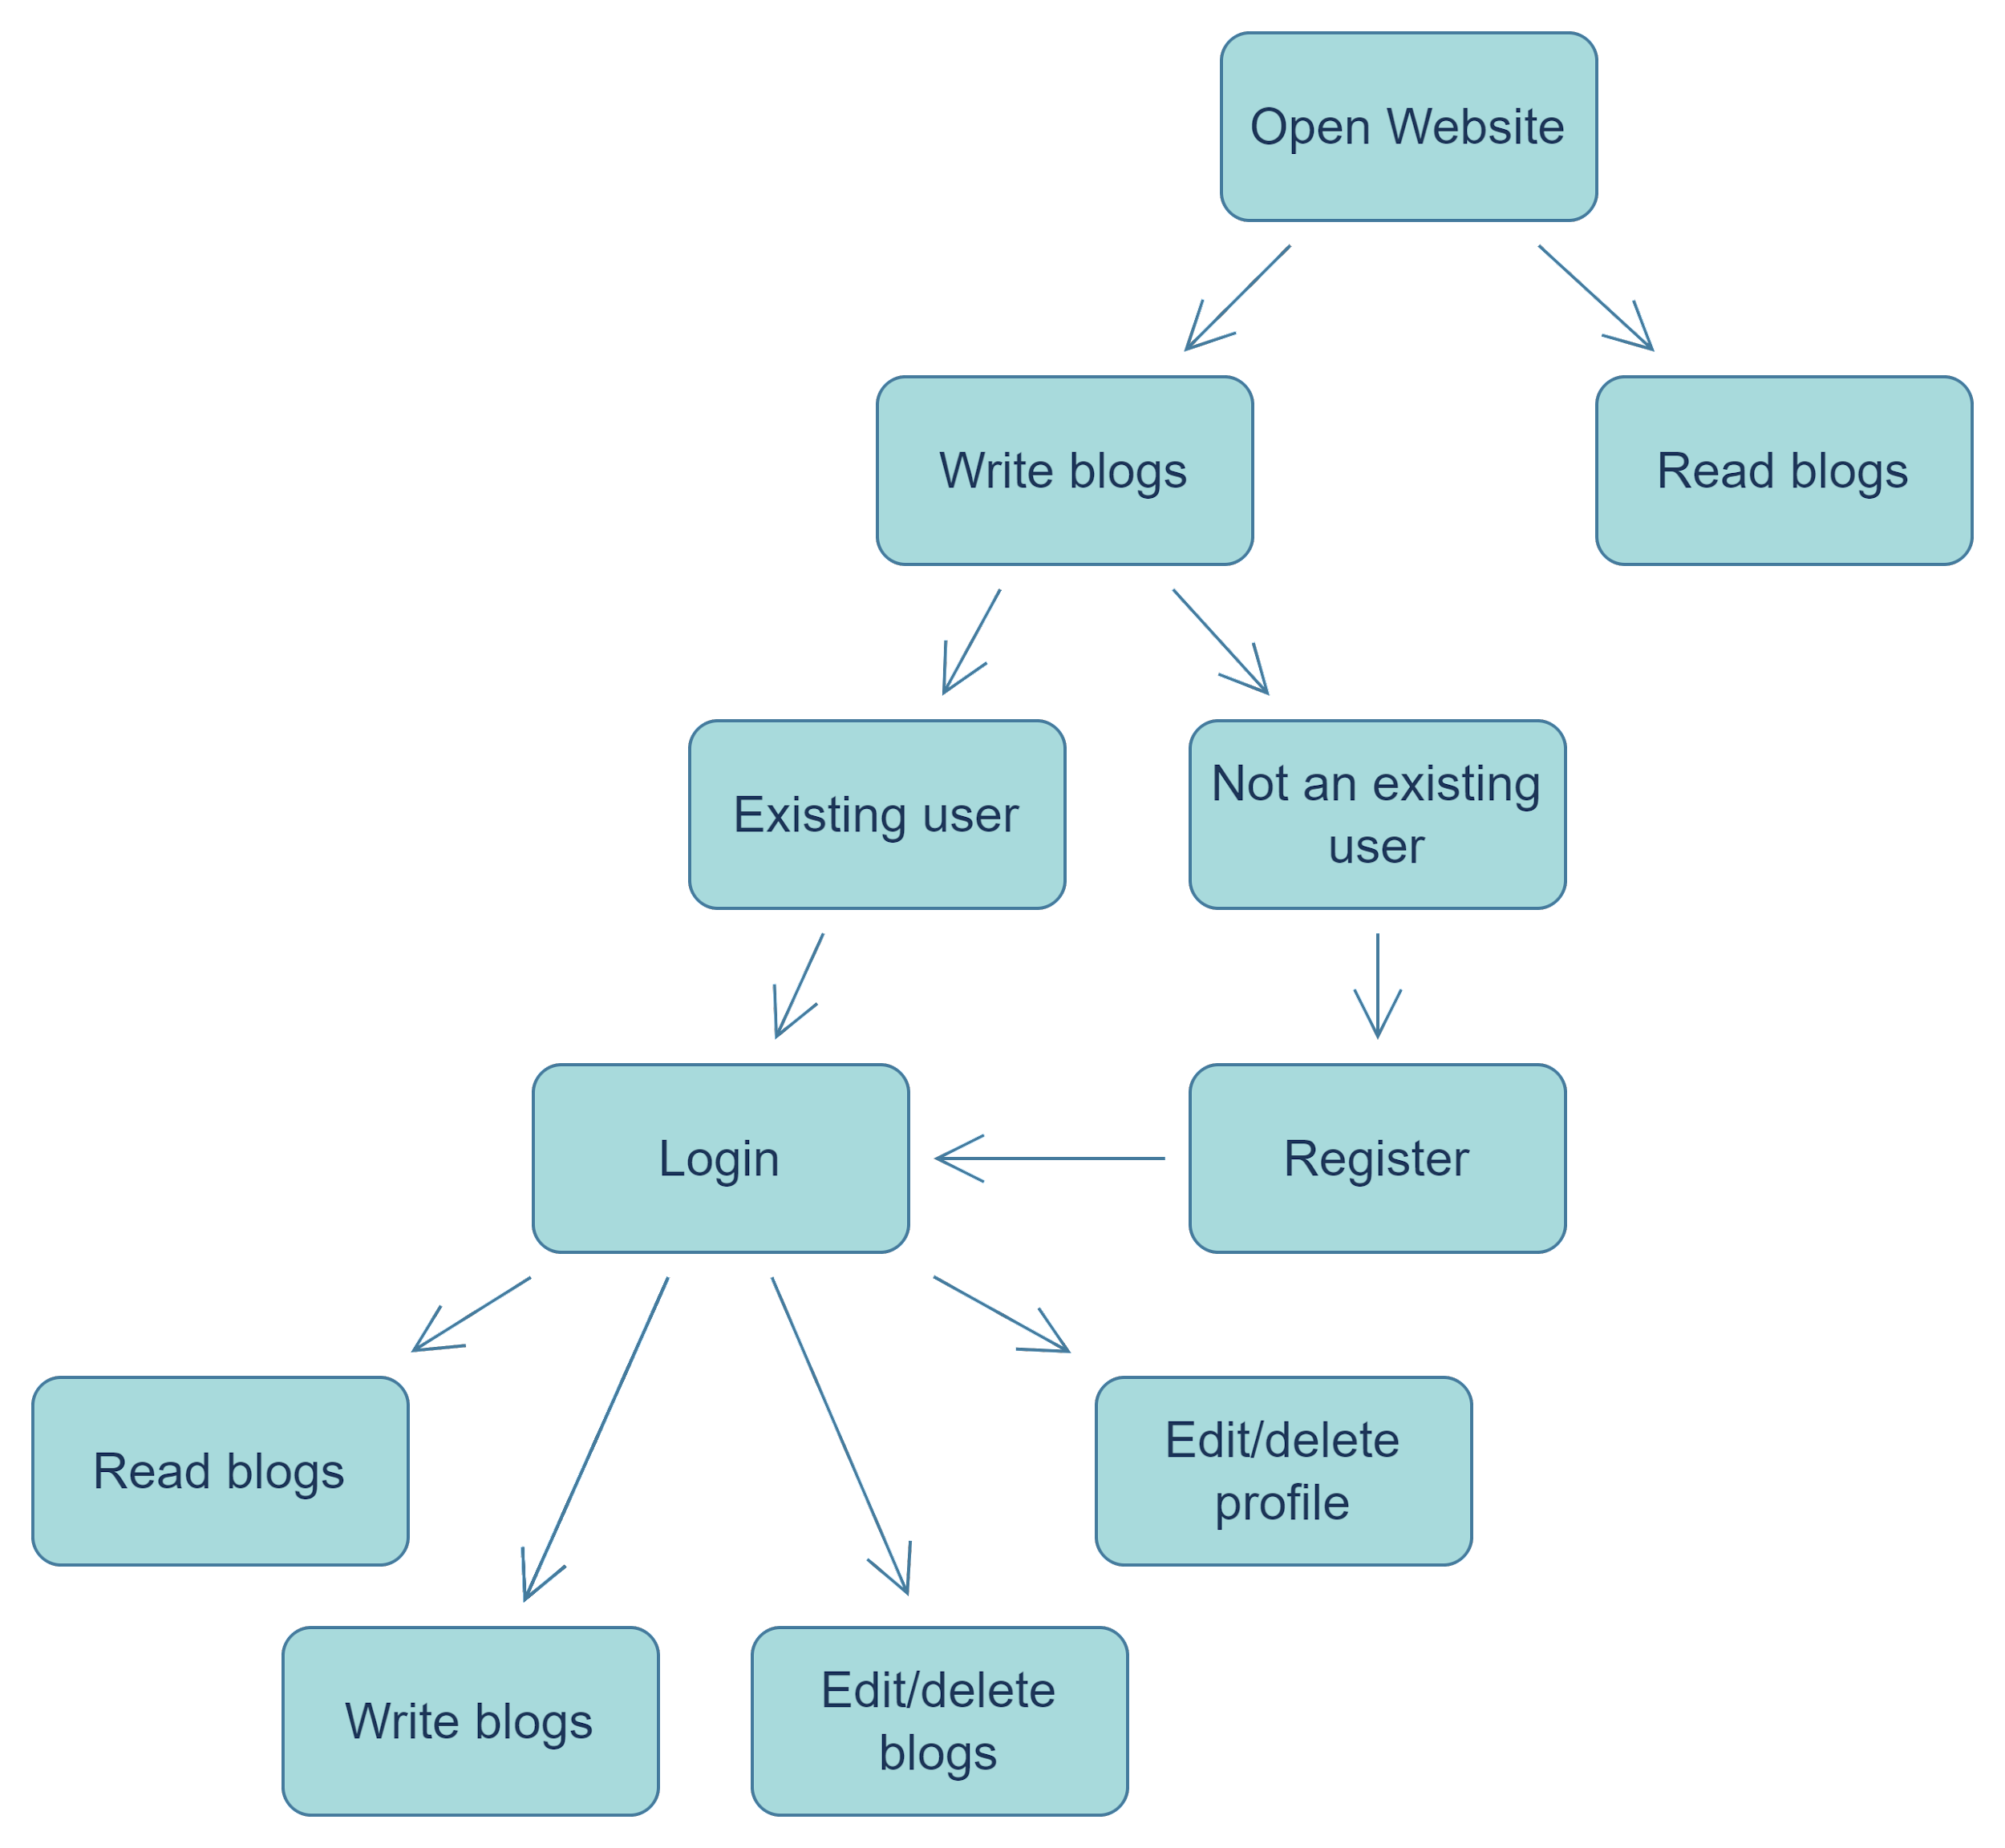
METHODOLOGY
SYSTEM DESIGN

Slide 9
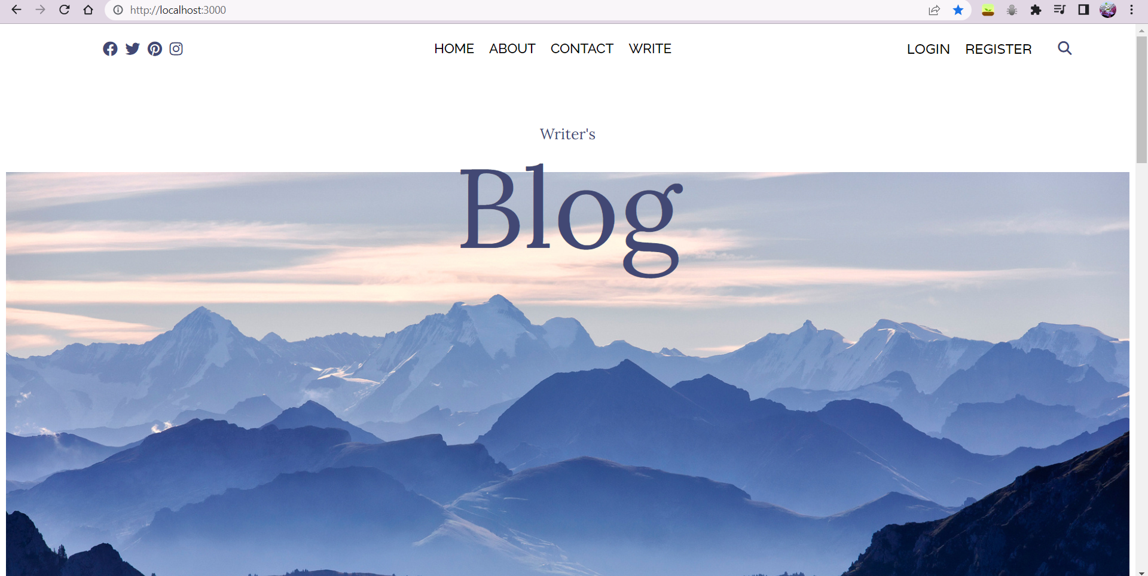
RESULTS
HOMEPAGE

Slide 10
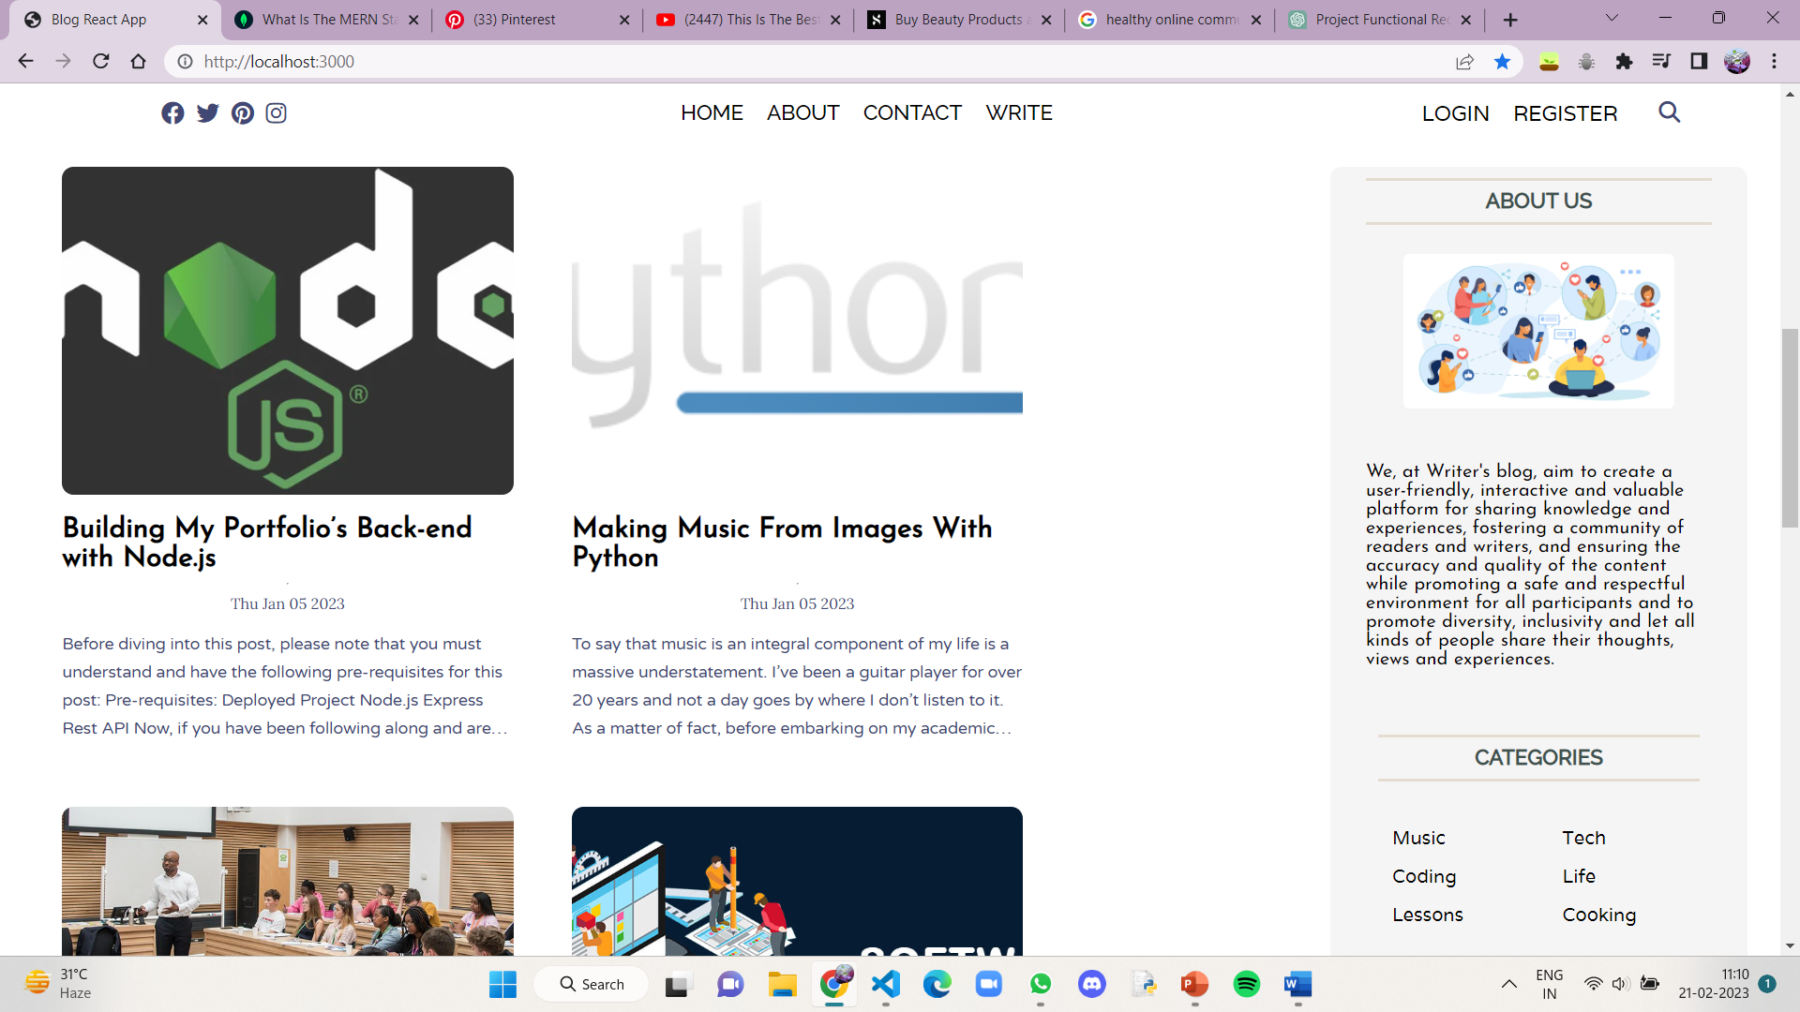
RESULTS(Contd.)
HOMEPAGE

Slide 11
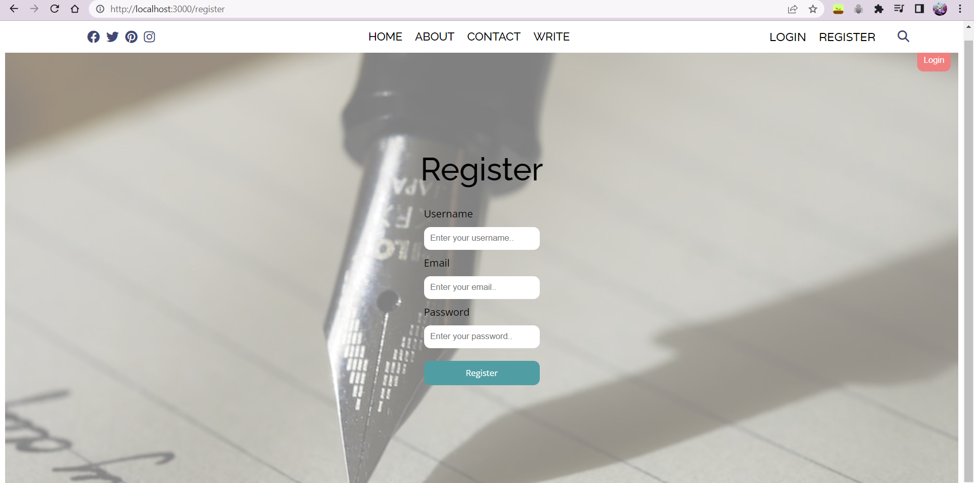
RESULTS(Contd.)
REGISTER PAGE

Slide 12
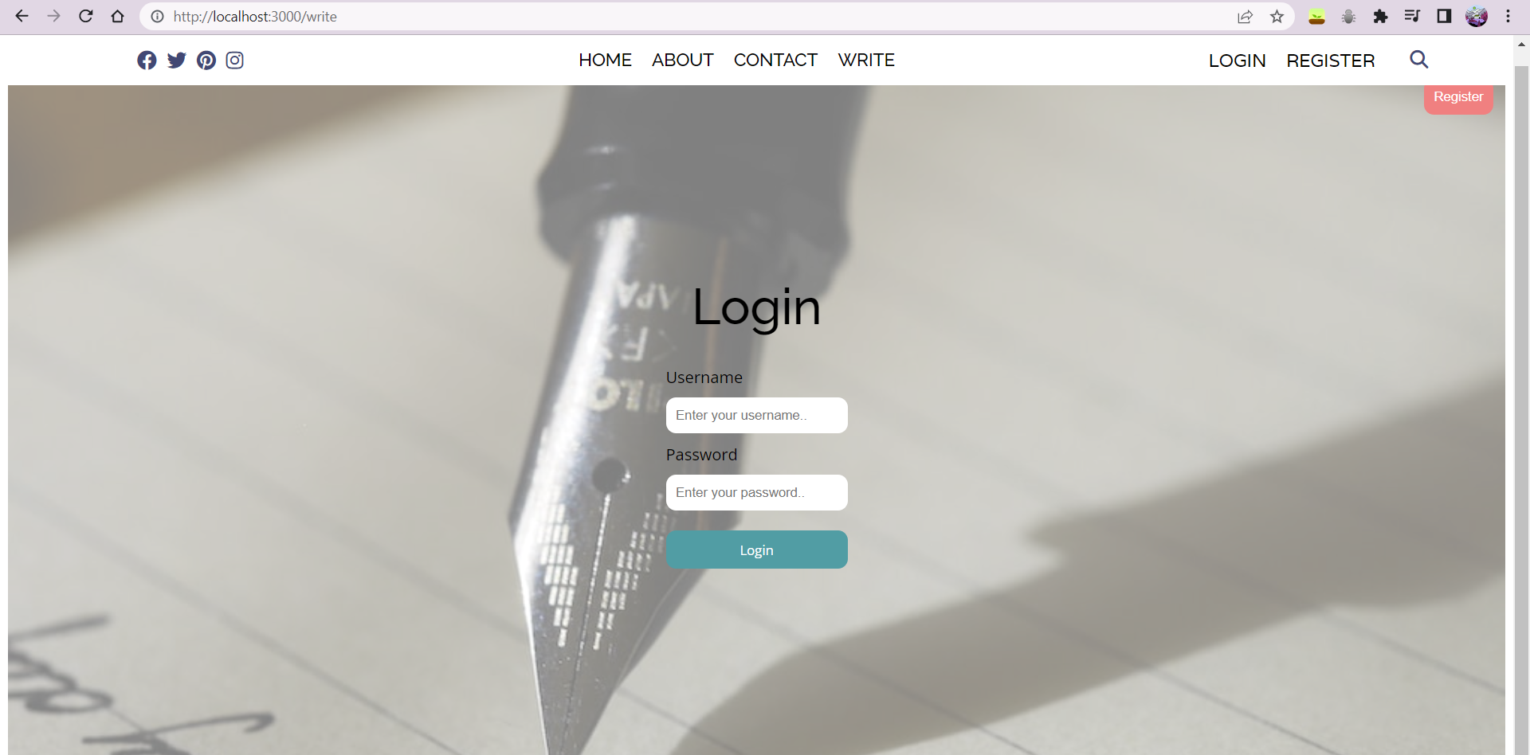
RESULTS(Contd.)
LOGIN PAGE

Slide 13
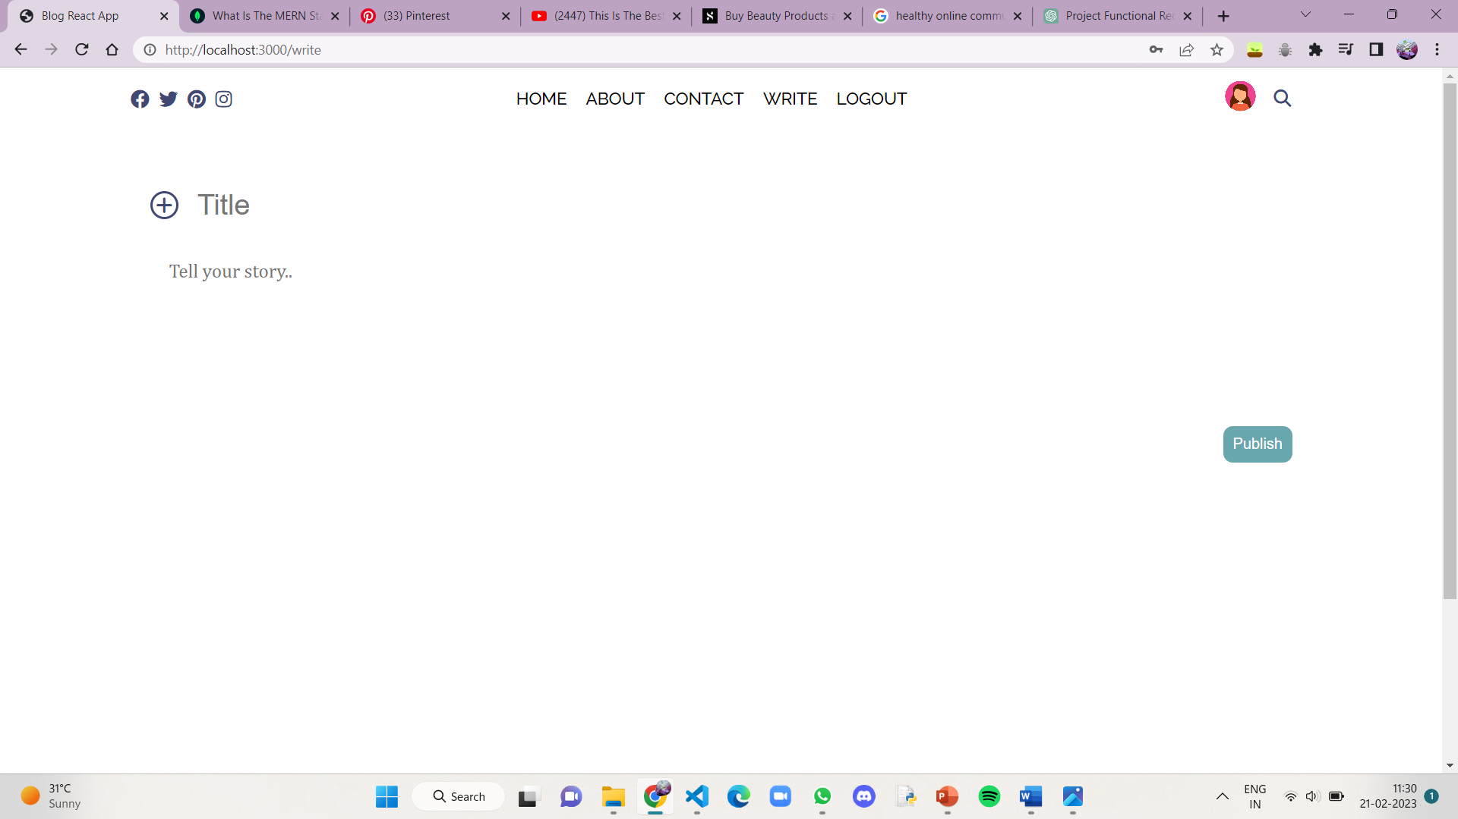
RESULTS(Contd.)
WRITE PAGE

Slide 14
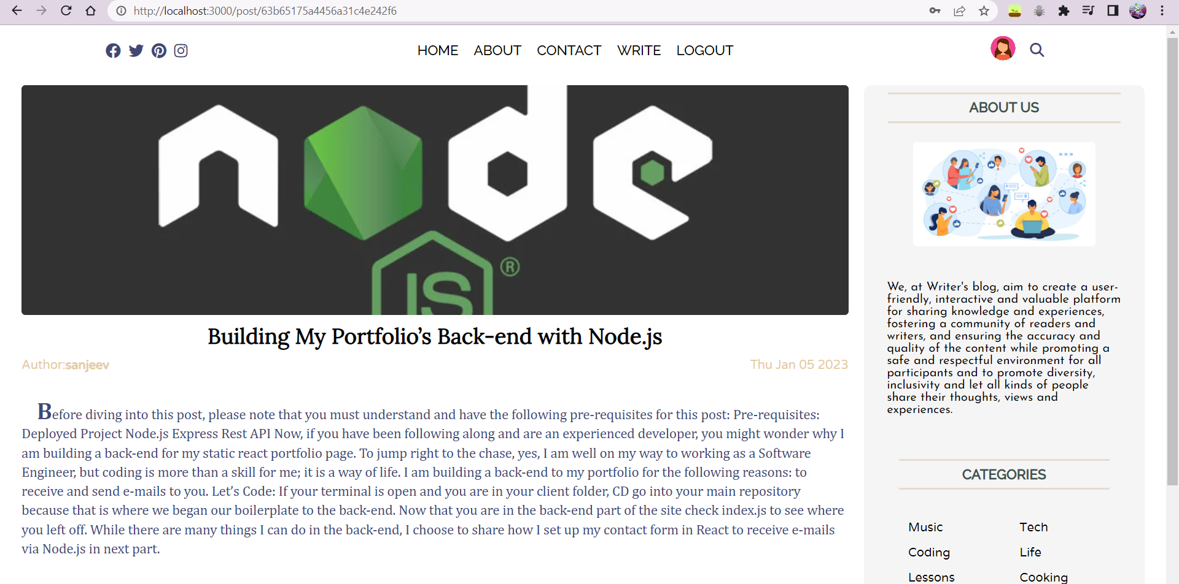
RESULTS(Contd.)
POST PAGE

Slide 15
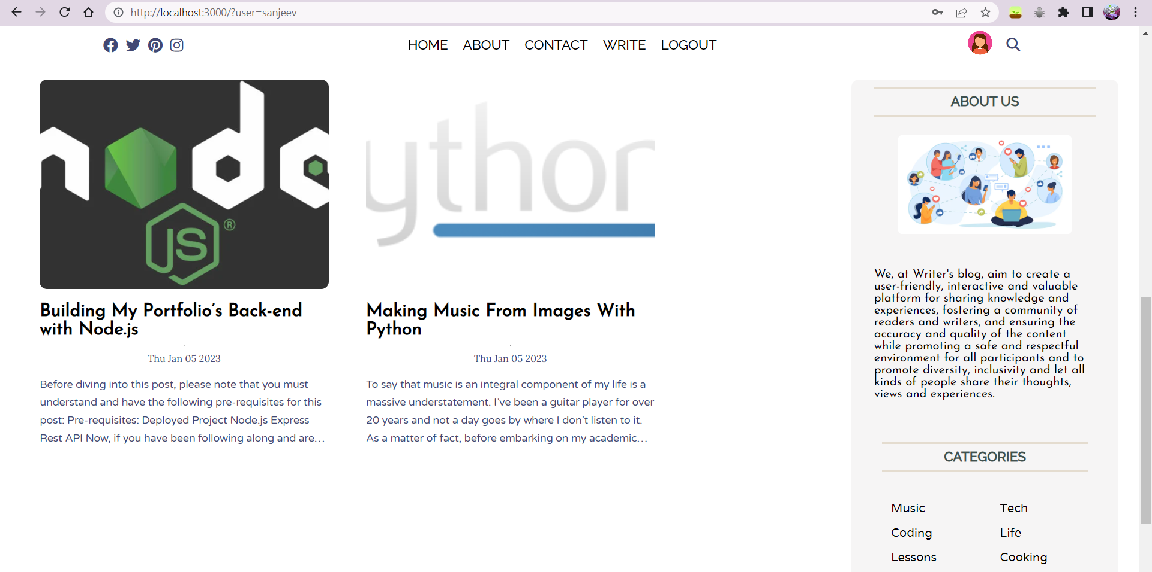
RESULTS(Contd.)
POSTS OF A SPECIFIC USER

Slide 16
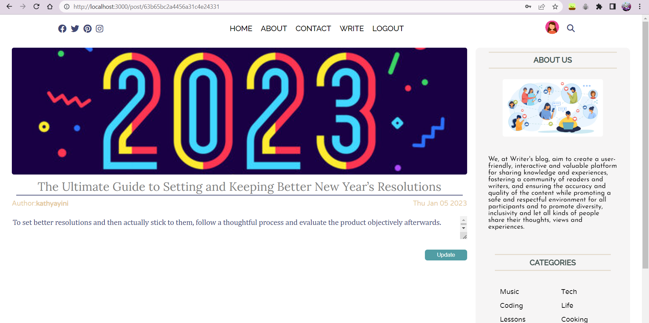
RESULTS(Contd.)
EDITING OR DELETING POSTS

Slide 17
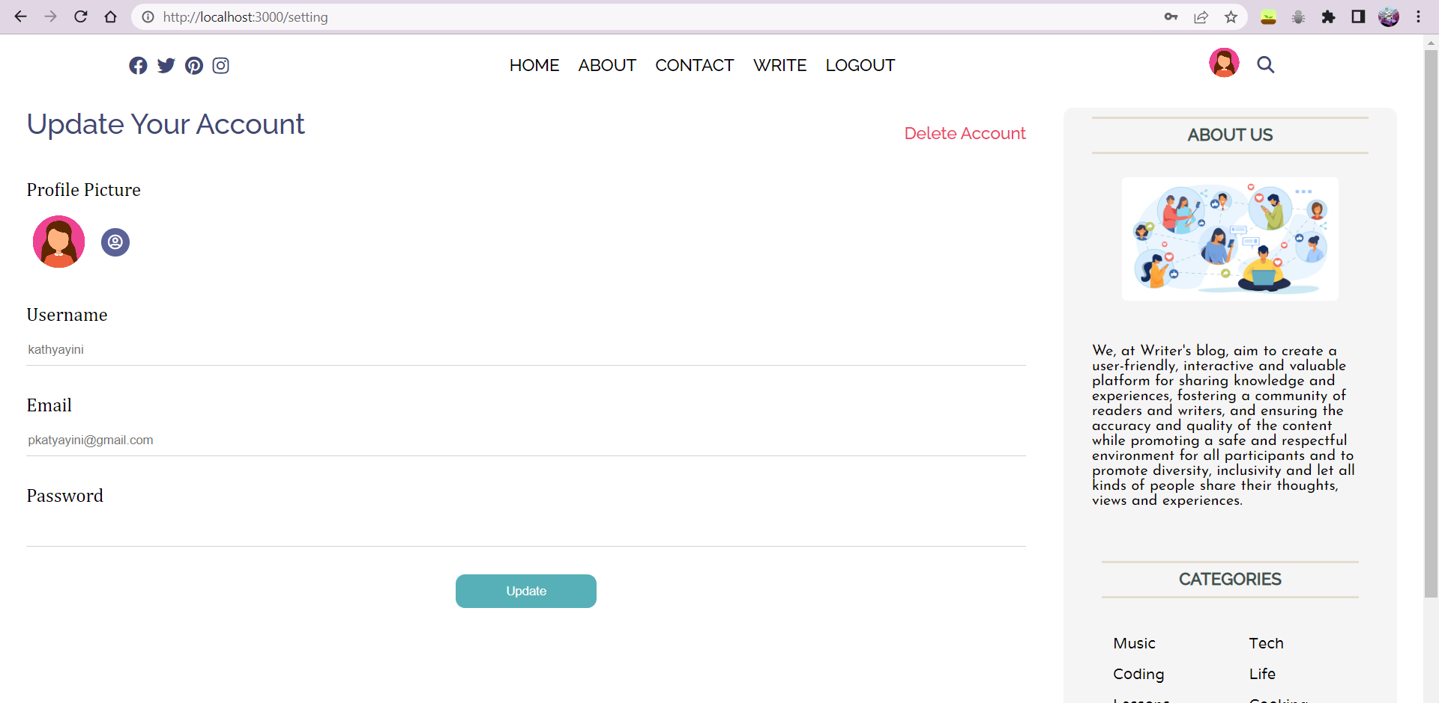
RESULTS(Contd.)
USER SETTINGS PAGE

Slide 18
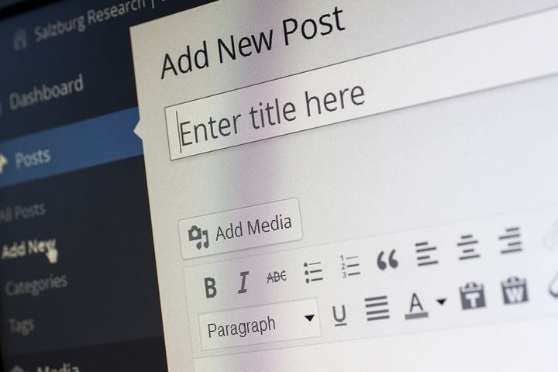
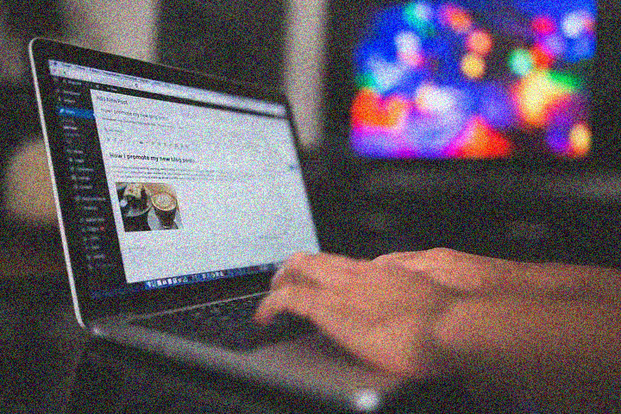
CONCLUSION
Our blog site developed using full stack development aims to provide a user-friendly and inclusive platform for individuals to express themselves, share their unique perspectives, and connect with others who share their interests and passions. By democratizing storytelling and empowering individuals to contribute to a culture of open and honest communication, we hope to create a diverse and engaged community where individuals can learn, grow, and inspire one another. Our platform offers a versatile tool for personal and professional branding, education and learning, community building, journalism, and artistic expression, making it an essential resource for anyone looking to share their ideas and make an impact in the world.

Slide 19
BIBLIOGRAPHY
https://medium.com/
https://reactjs.org/
https://expressjs.com/
https://www.postman.com/
https://www.w3schools.com/html/html_css.asp

Slide 20

THANK YOU

